Slide 1


Smart Trash System
Supervised by: Dr. Hussein Nasrallah
Committee Member: Dr. Soha Farhat
Presented By Ali Hamieh 32230601 | Mikeal Moussa 32230163

Slide 2
Background
• Rapid population growth increases waste generation.
• Manual sorting is slow and error-prone.
• Poor waste segregation reduces recycling efficiency.
• Smart technologies can automate waste management.

Slide 3
Problem Statement
• Recyclable materials are often mixed with general waste.
• Manual sorting requires time and labor.
• Traditional bins provide no monitoring or intelligent sorting.
• Need for an automated, accurate, and sustainable solution.

Slide 4
Project Objectives
• Automatically identify waste materials.
• Sort waste into correct compartments.
• Monitor bin fill levels.
• Reduce human intervention.
• Improve recycling efficiency and sustainability.

Slide 5
System Overview
User inserts waste → ESP32 Camera captures image → AI model classifies material → Arduino receives result → Servo motors sort waste → Ultrasonic sensors monitor fill levels.

Slide 6
Hardware Components
• Arduino Uno (main controller)
• ESP32 Camera Module
• 3 Servo Motors
• Ultrasonic Sensors
• Wi‑Fi Communication
• Wood and Cardboard Structure

Slide 7
AI-Based Waste Classification
• ESP32 captures waste images.
• Images are sent to a laptop via Wi‑Fi.
• AI model analyzes the image.
• Material is classified as Plastic, Metal, Glass, or Paper.
• Classification result is sent to Arduino.

Slide 8
Sorting Mechanism
• Top Servo (Pin 9) performs initial routing.
• Right Servo (Pin 10) controls right-side compartments.
• Left Servo (Pin 11) controls left-side compartments.
• Arduino coordinates movements and resets servos after sorting.

Slide 9
Monitoring and Dashboard
• Ultrasonic sensors measure compartment fill levels.
• Real-time status updates are displayed..
• Dashboard provides clear monitoring of system operation.

Slide 10
Implementation Tools
Hardware: Arduino Uno, ESP32 Camera, Servo Motors, Ultrasonic Sensors.
Software: Arduino IDE, Python, AI Model, Visual Studio Code, Android Studio, PHP, SQLite

Slide 11
Testing and Results
• Waste detection and image capture passed.
• AI classification performed successfully.
• Sorting mechanism operated correctly.
• Fill-level monitoring worked as expected.
• Wi‑Fi communication was reliable.

Slide 12
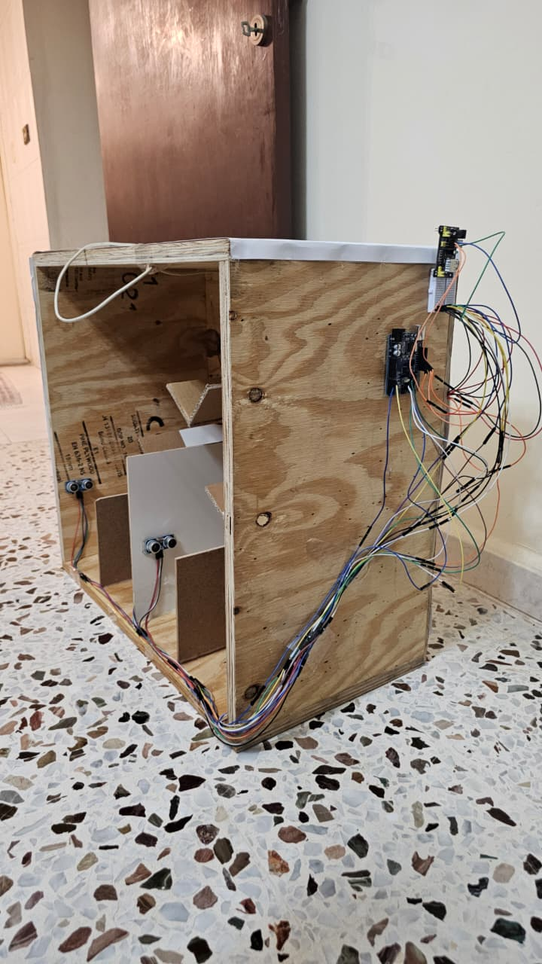
Implimentation Result

Slide 13
Similar Systems
SmartBin :IoT fill-level monitoring and notifications
Bin-e : AI-based waste recognition and automatic sorting
Our Smart Trash System :AI image classification, Arduino-controlled servo sorting, ESP32 Camera, ultrasonic fill monitoring, IoT connectivity

Slide 14
Benefits and Future Work
Benefits: Automated sorting, improved recycling, reduced manual effort.
Conclusion: The system successfully integrates AI, IoT, and embedded systems.
Future Work: Higher-accuracy AI, cloud platform, mobile app enhancements, GPS tracking, solar-powered operation.

Slide 15
Conclusion
The Smart Trash System is an intelligent solution that uses AI, IoT to improve waste sorting. It can identify different types of waste, sort them automatically, and monitor bin fill levels in real time.
The system was successfully tested and showed reliable waste detection, sorting, and monitoring. It reduces manual work, supports recycling, and helps create a cleaner environment

